Slide 1
National institute of technology Calicut NITC Conference Room Booking System Guided by : Dr. Anu Mary Chacko
Prepared by : Team No.12
Arham Siddiki M210695CA
Joel Lalrinnunga Ralte M210694CA
Rajkumar Rajput M210666CA

Slide 2
Why NITC CRBS(Conference Room Booking System)
At the time of urgent need(and non urgent as well), going to offices to get the conference room booking permission for your work gets hectic and time consuming as well. You need to get a letter signed from respective authorities and keep the permission safely with you.
Also, for authorities it may get difficult to keep a track of these bookings and holding people accountable in case of some items misplaced or damaged in that conference room.
NITC CRBS is here to eradicate all these problems by providing mobile bookings from place of your comfort. Also you don’t need to carry your heavy laptops since this software is in form of an Android application. So you can make bookings on your fingertips at anywhere and anytime.

Slide 3
Introduction
NITC Conference Room Booking System is a simple Application to facilitate booking of various conference rooms available in institute by providing an easy to access Android interface.
Main goal of this system is to digitalise the current system for conference room booking of institute.
The project core part is reservation and booking system to keep track of the reservation and room availability.

Slide 4
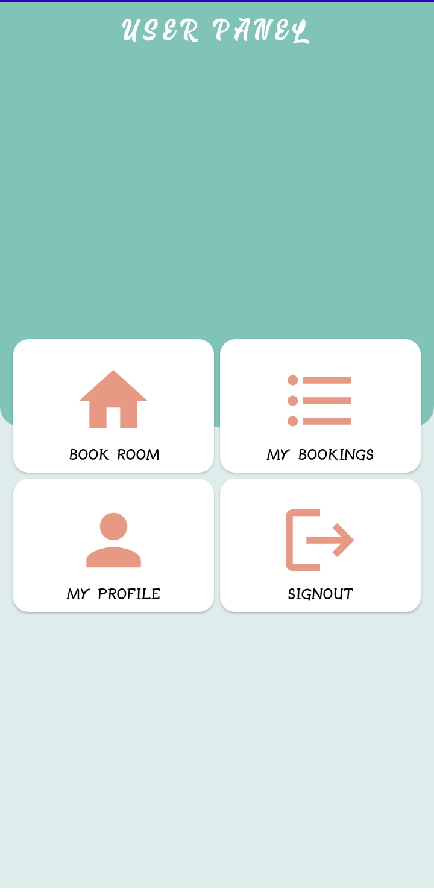
Product Features
A. User Features
User can register/login themselves.
User can view available conference rooms.
User can book a conference room by providing a valid date, time, purpose and faculty(optional).
User can view status of their booking.
User can view the suggestion made by the admin in case their booking is rejected.
User can view and edit their profile.

Slide 5
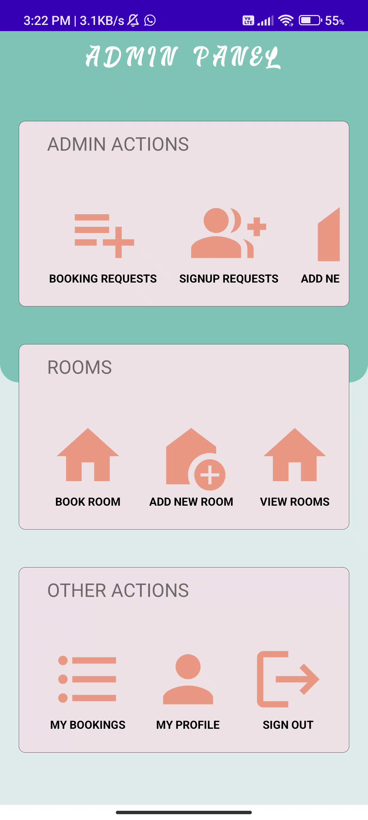
B. Admin Features
Admin can perform all actions of normal user (Part A : points 1-6).
Actions exclusive to Admin are :-
Admin can add/remove some conference room.
Admin can view/accept/reject the booking requests made by users.
Admin can suggest an alternate room to user, in case he has to reject the booking request.
Admin can view all upcoming/past bookings.
Admin can accept/reject new admin requests.

Slide 6
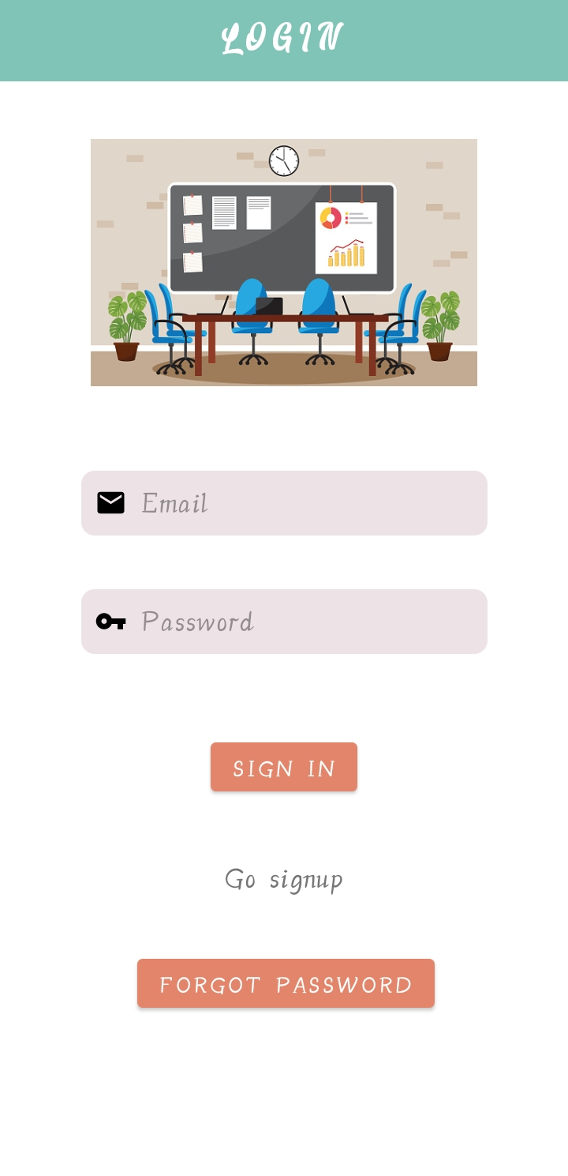
A 1 : User can login/register.
This interface is about the login page where the user needs to enter their username and password to login to the system.
User can also reset their password securely in case they forget it.

Slide 7
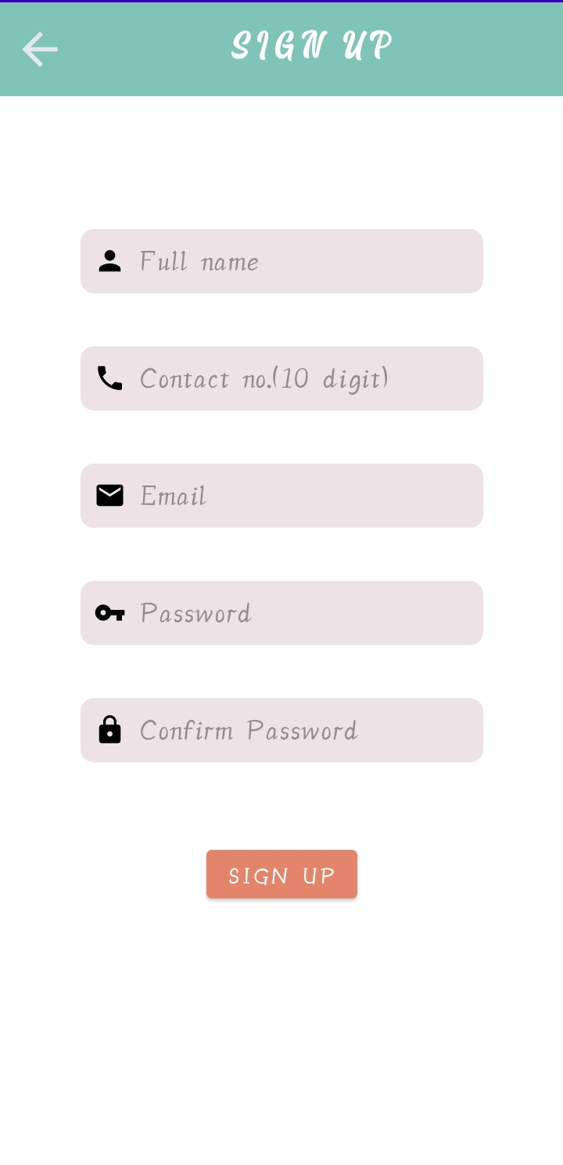
A 1 : User can login/register(cont.).
This interface is of Register where new users can register themselves by providing details such as required details.
User will have to confirm their email address before they can access their new account.
*One can signup as admin by typing as “Admin” in name name field. But an existing admin will have to accept his request to authorize him as an admin.

Slide 8
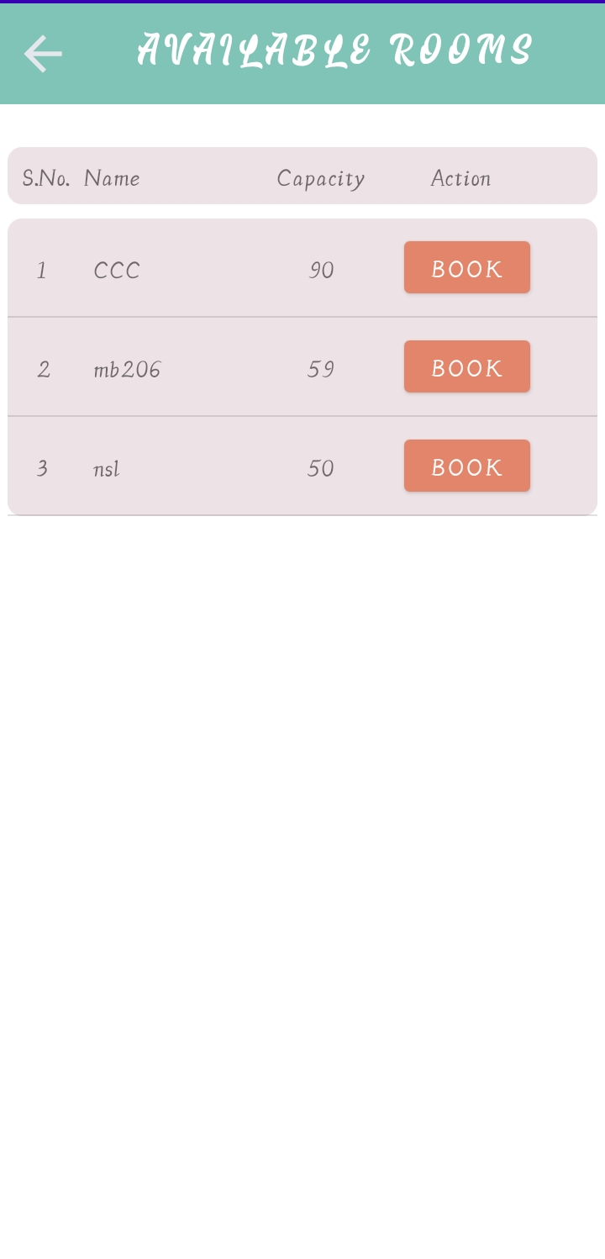
A 2 : User can view available conference rooms.
User can view available conference rooms and their respective capacities. They may also choose to book any of them.

Slide 9
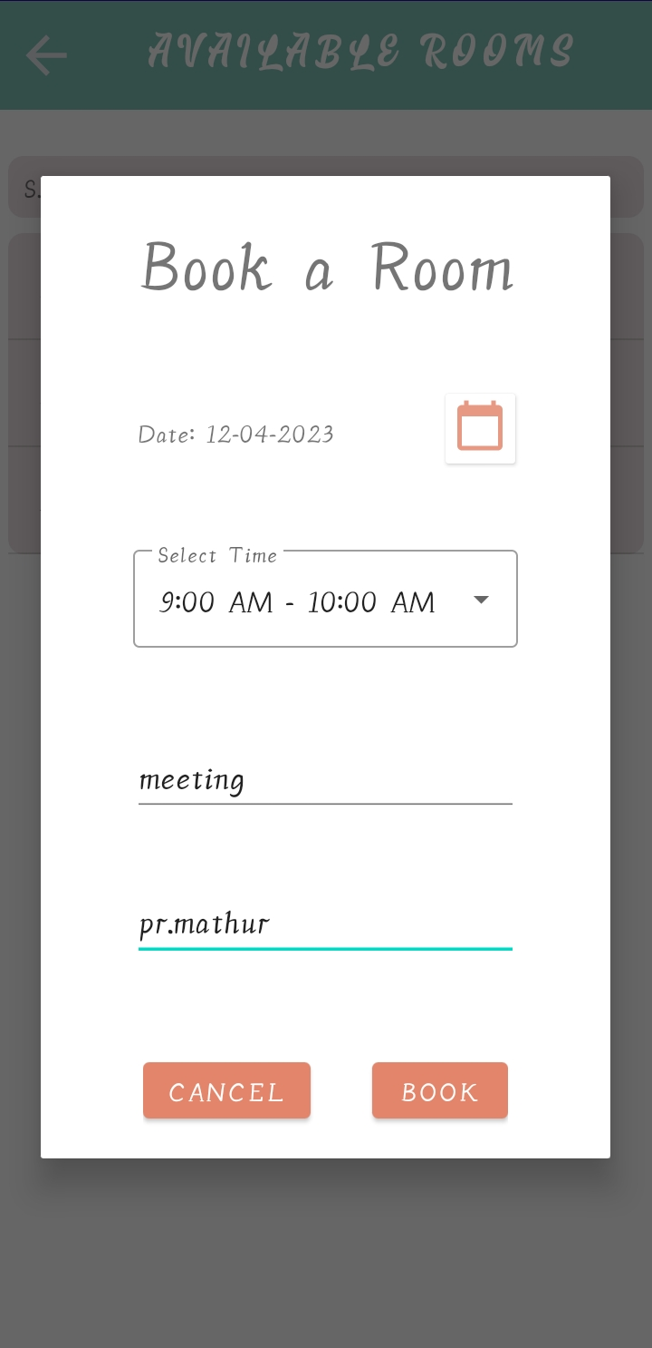
A 3 : User can book available conference rooms.
User can book a conference room by providing details required.
Details are :
Date
Time
Booking purpose
Supervising faculty

Slide 10
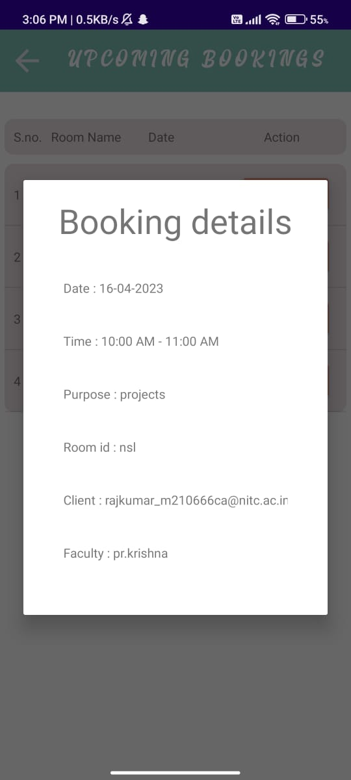
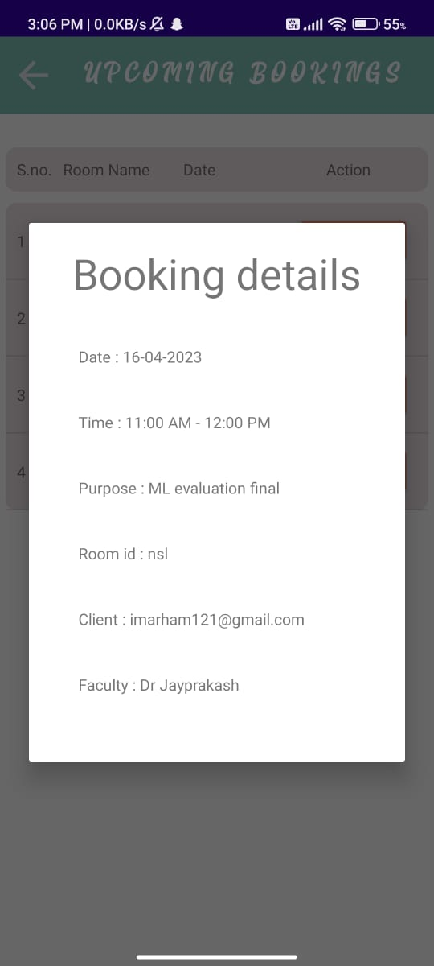
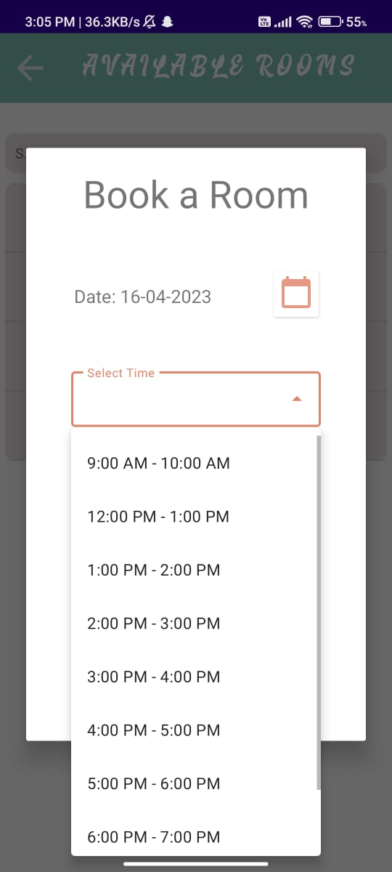
A 3 : User can book available conference rooms(cont).
Time slots already booked for that date will not be shown.

Slide 11
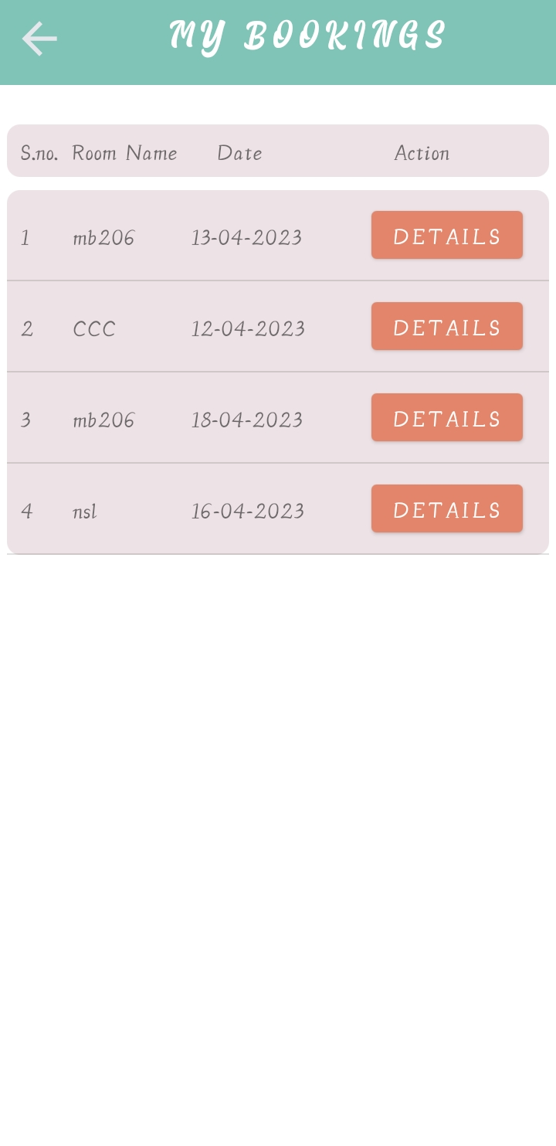
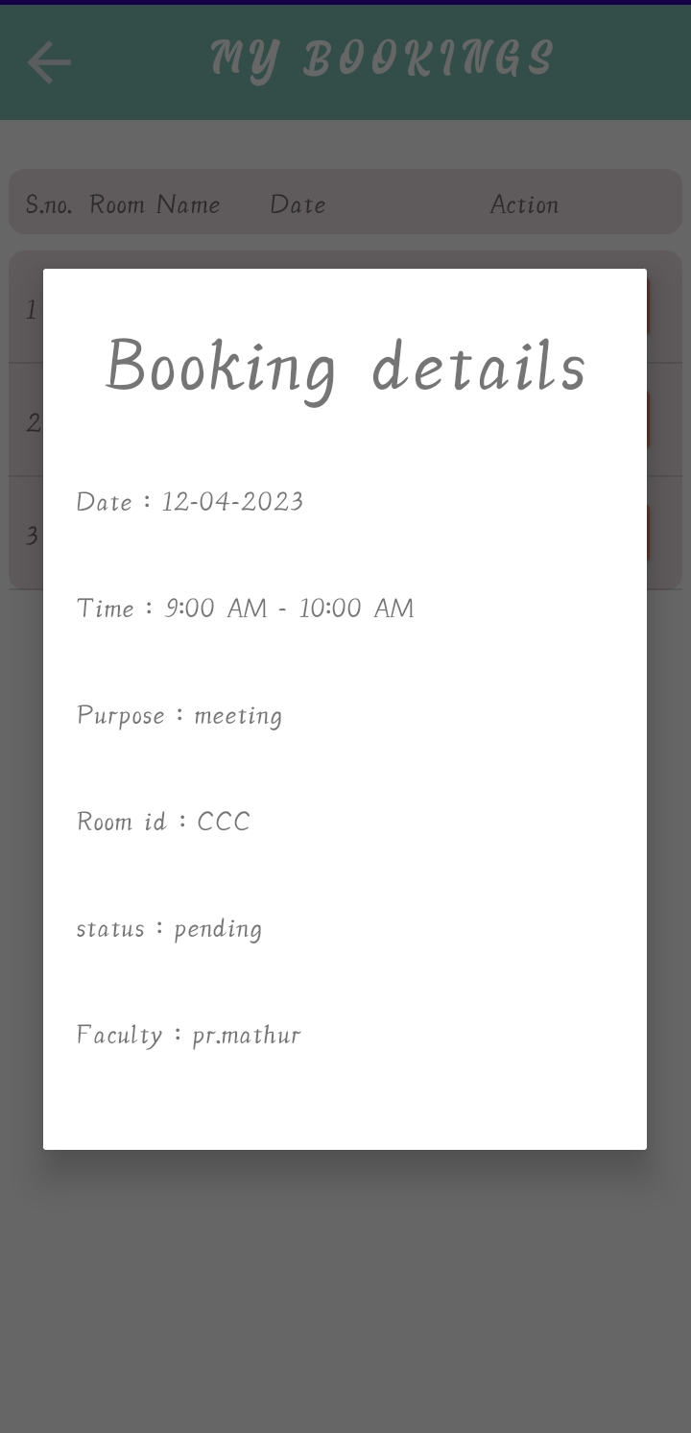
A 4 : User can view status of their booking.
Users can see whether their booking request is accepted or rejected or pending action from admin.
User will see suggestions made by admin in case his request is rejected.

Slide 12
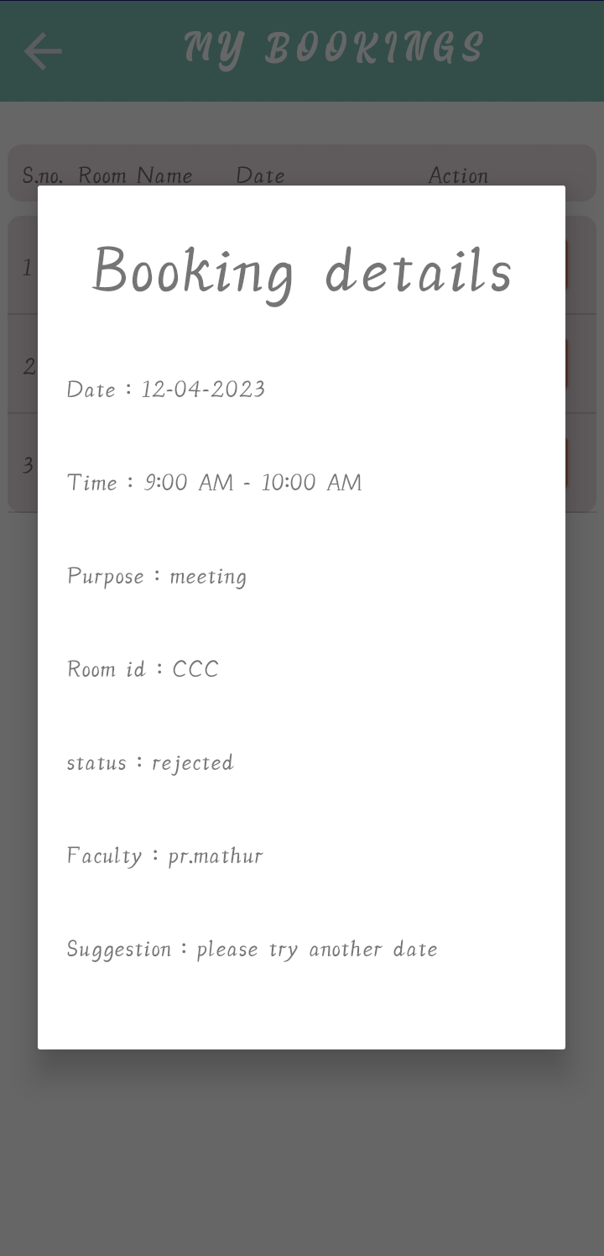
A 5 : User can view the suggestion made by the admin if their request is rejected.
Users can see whether their booking request is accepted or rejected or pending action from admin.
User will see suggestions made by admin in case his request is rejected.

Slide 13
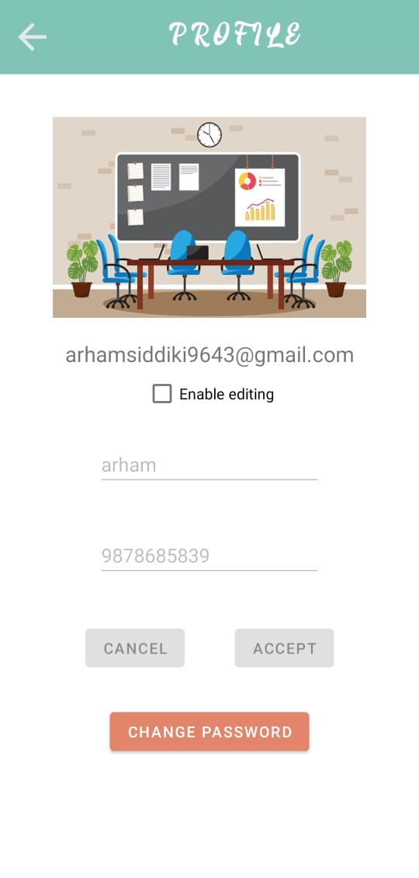
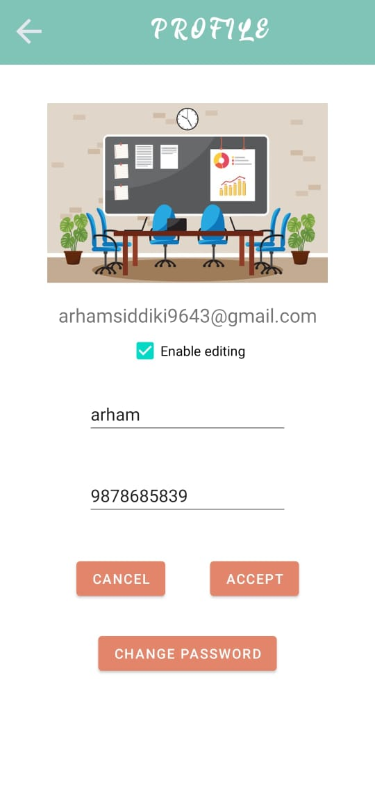
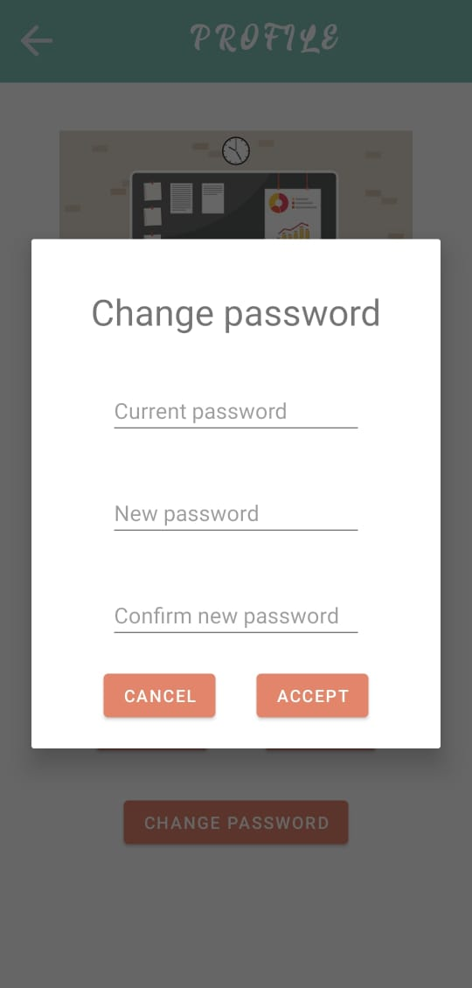
A 6 : User can view and edit their profile.
Users can view and update their details.

Slide 14
B. Admin Functionality
Admin can perform all actions of normal user (Part A : points 1-6).
Actions exclusive to Admin are :-
Admin can add/remove some conference room.
Admin can view/accept/reject the booking requests made by users.
Admin can suggest an alternate room to user, in case he has to reject the booking request.
Admin can view all upcoming/past bookings.
Admin can accept/reject new admin requests.

Slide 15
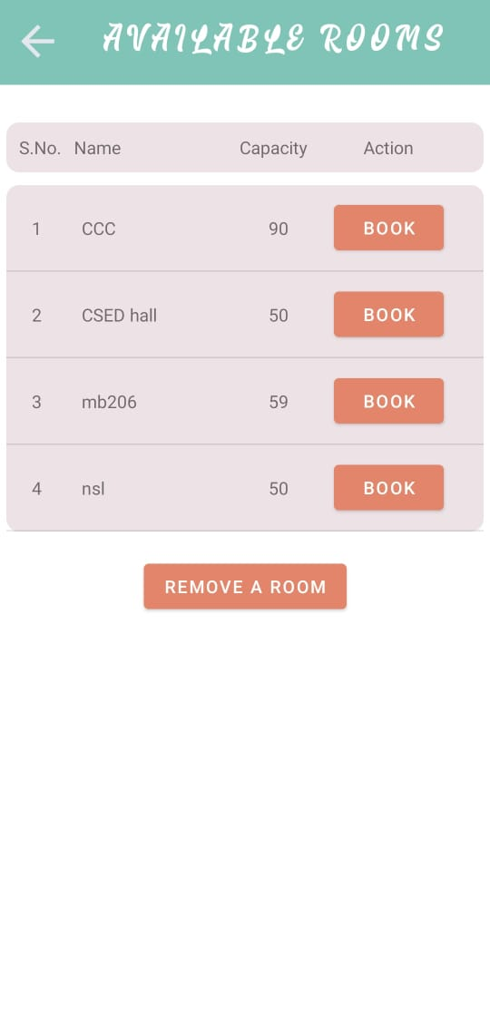
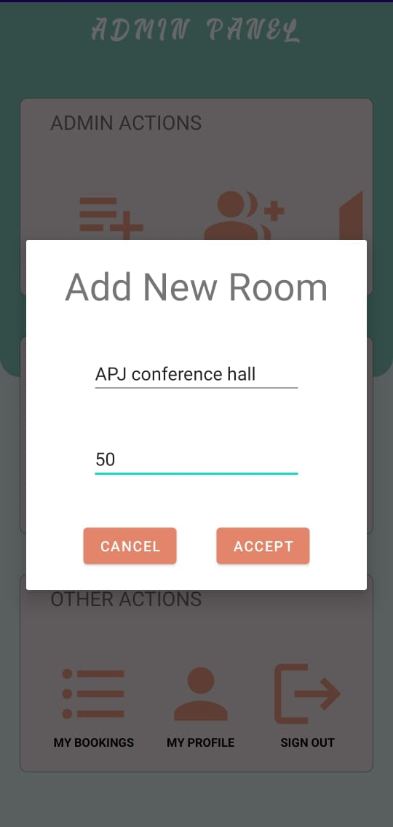
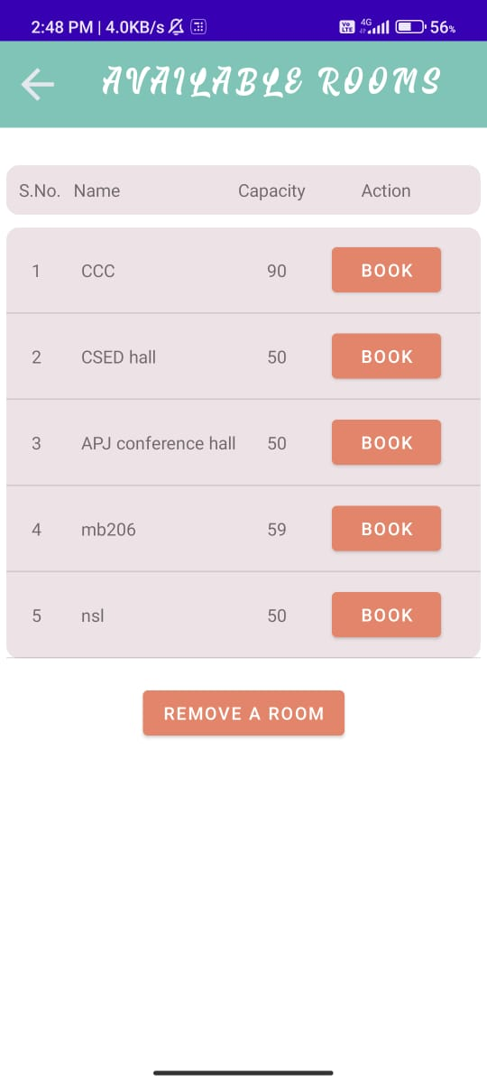
B 1 : Admin can add/remove some conference rooms.

Slide 16
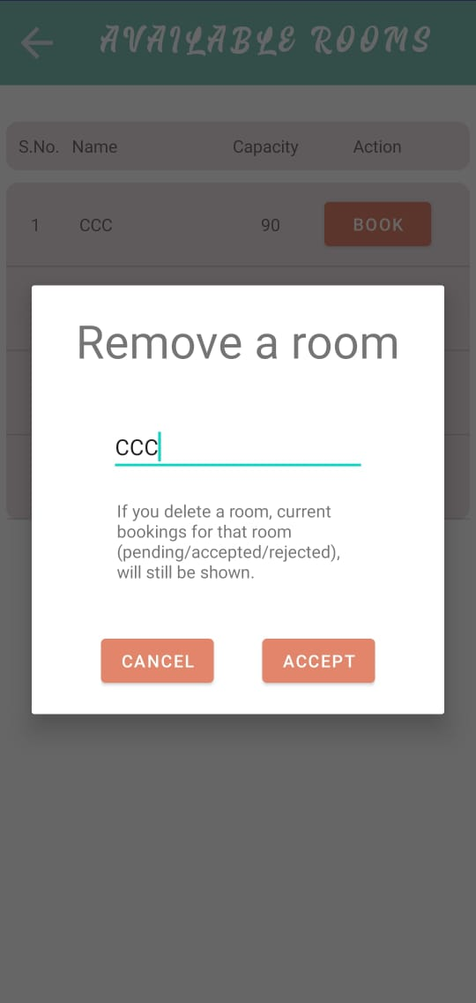

B 1 : Admin can add/remove some conference rooms(cont.)

Slide 17
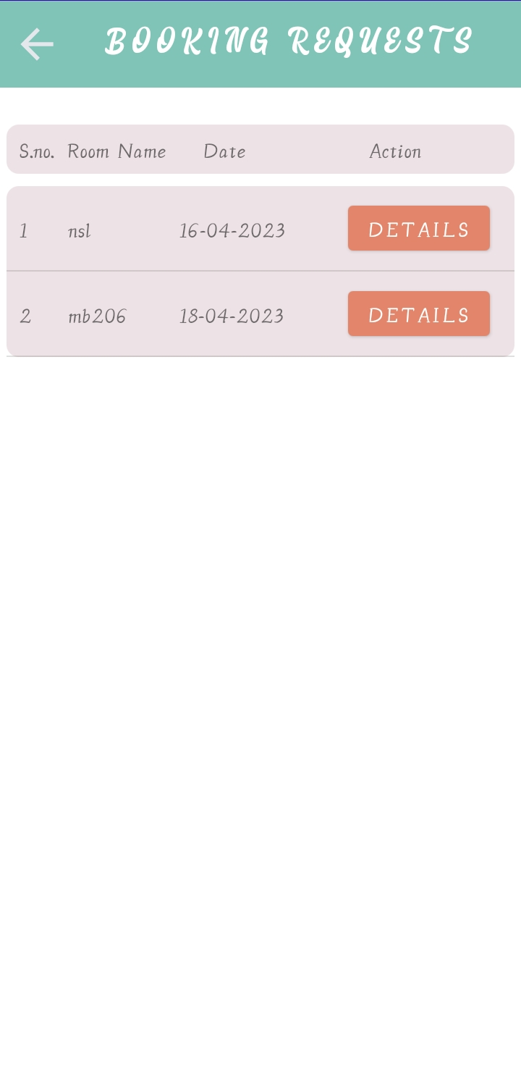
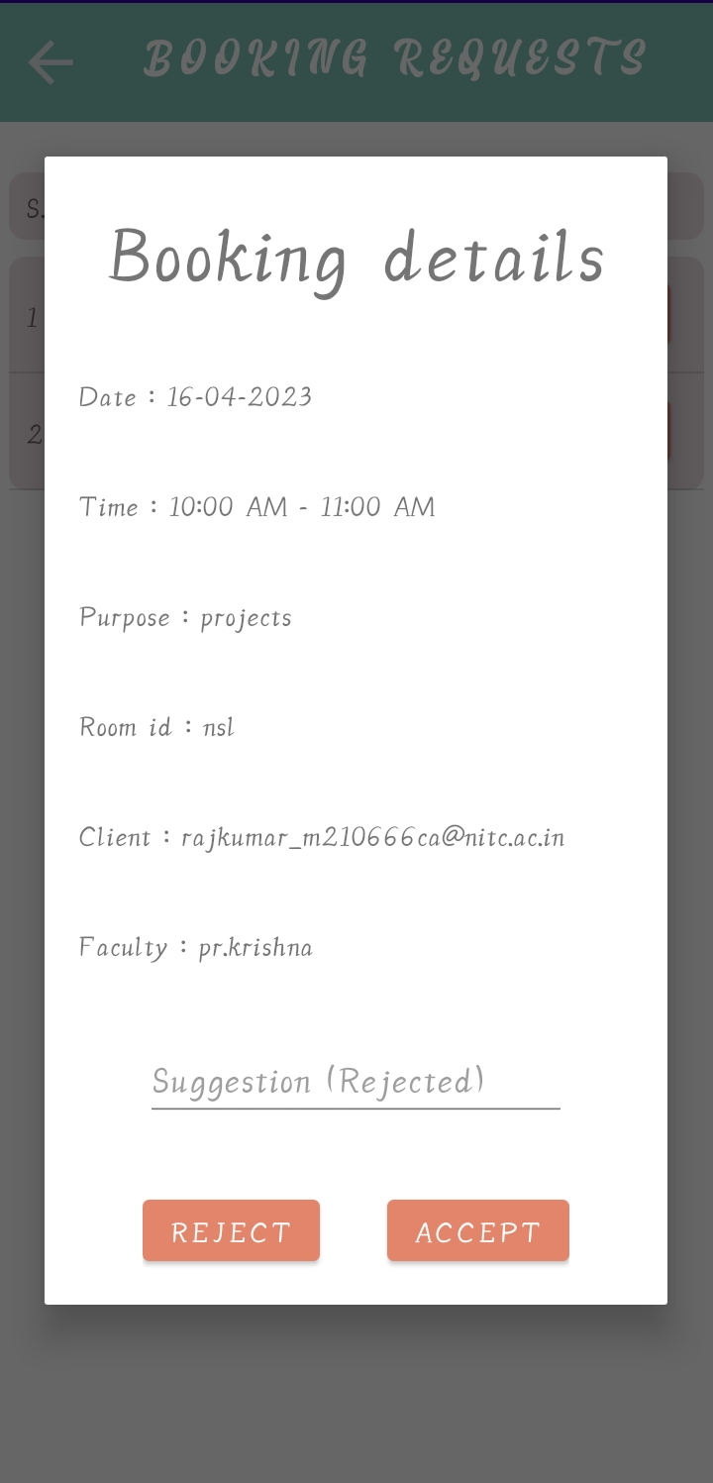
B 2 : Admin can view/accept/reject the booking requests.
B 3 : Admin can suggest an alternate booking while rejecting a request.

Slide 18
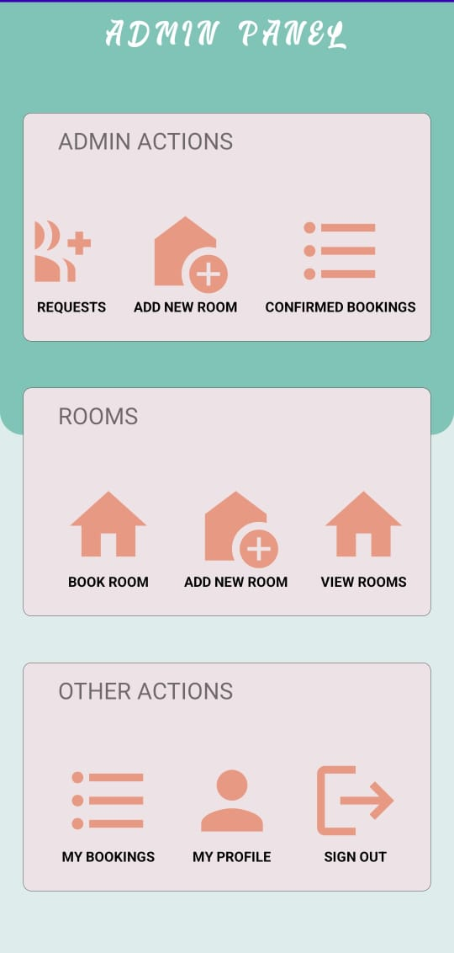
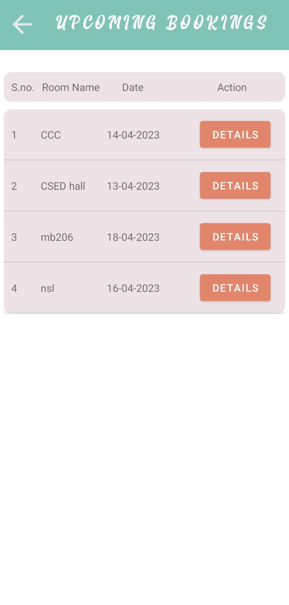
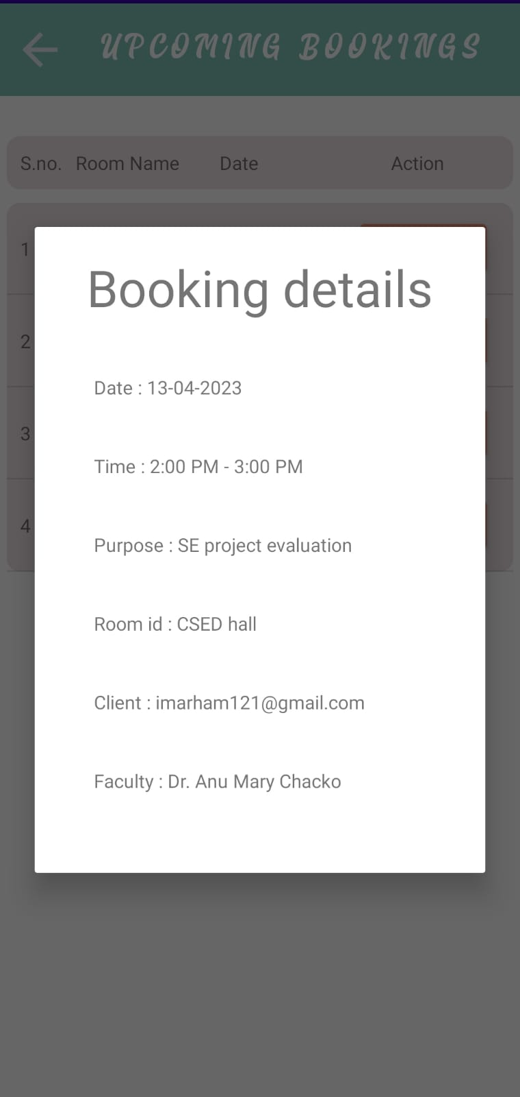
B 4 : Admin can view all upcoming/past bookings.

Slide 19
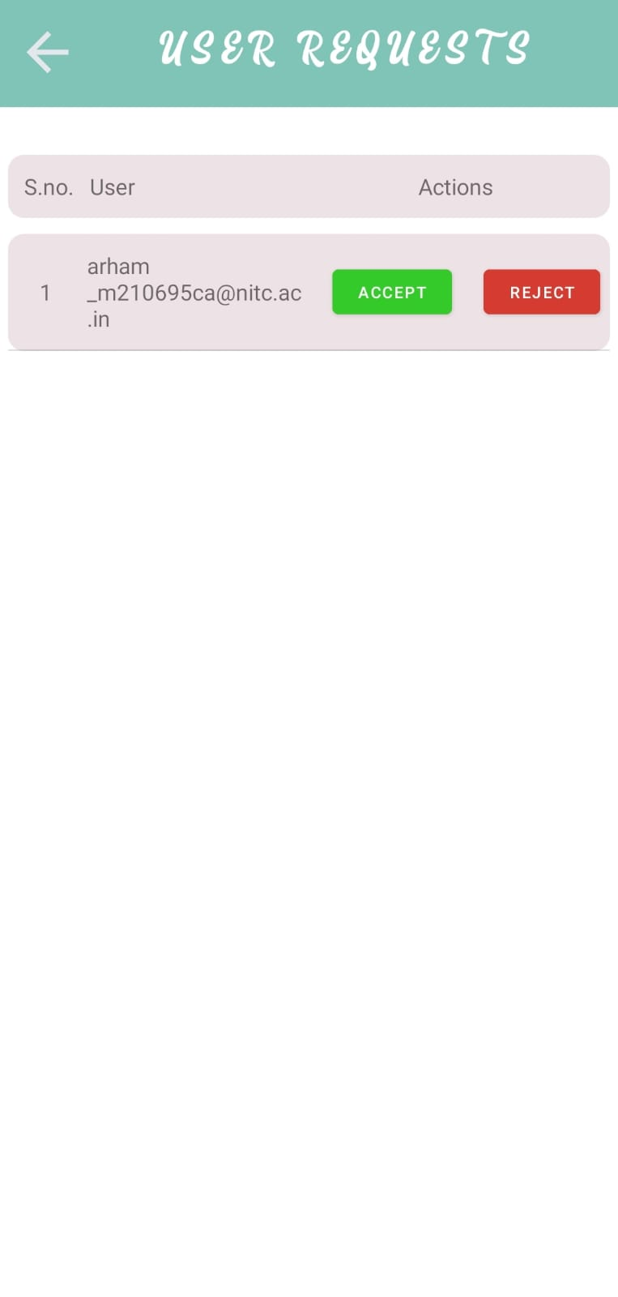
B 5 : Admin can accept/reject new admin requests.
Admin can accept/reject this request.
If admin accept this request, “@arham_m210695ca@nitc.ac.in” will have admin access to the system.

Slide 20
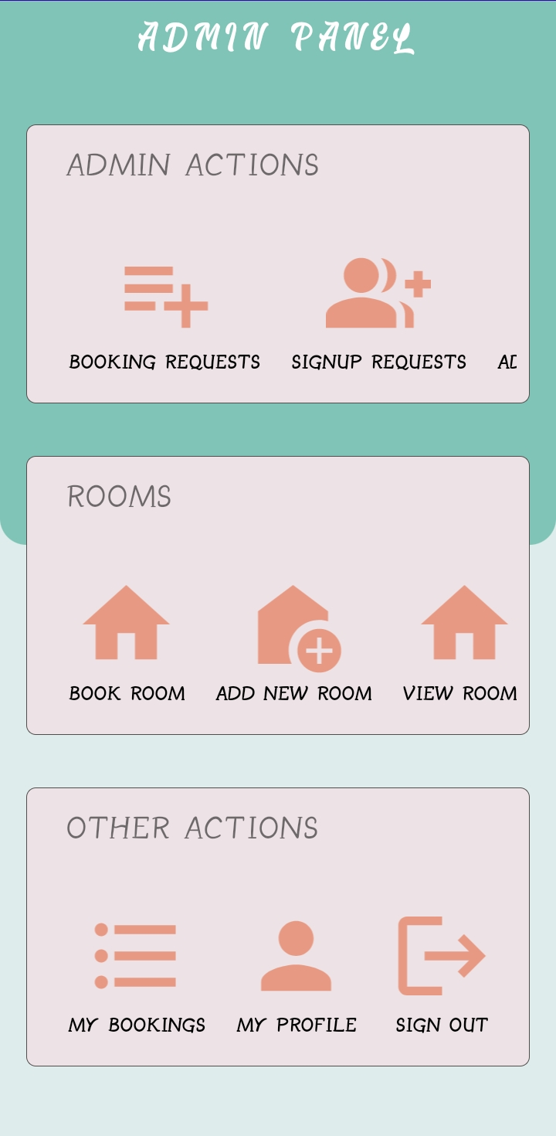
There is signout button to logout and allow new user to login to system on that device.

Slide 21
Thank you

